Slide 1

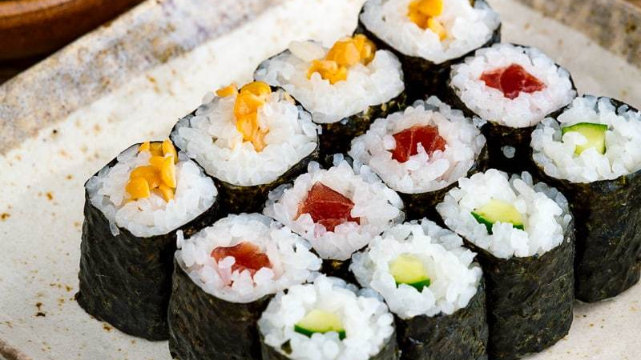
The Battle of Neighborhoods - Where to start a Sushi restaurant in Calgary, Alberta ?
APPLIED DATA SCIENCE
CAPSTONE PROJECT
By RAHUL T N U NAIR

Slide 2
Agenda
Introduction
Data and EDA
K-means Clustering
Recommendations
Future considerations

Slide 3
INTRO: ABOUT CALGARY
Calgary is a city in the western Canadian province of Alberta, Canada
80 km east of the Canadian Rockies.
Biggest city in Alberta and the second largest in western Canada after only Vancouver
Calgary the most livable city in North America in both 2018 and 2019
The Calgary Metropolitan Region is home to Canada's second-highest number of corporate head offices among the country's 800 largest corporations.
In 2015 Calgary had the highest number of millionaires per capita of any major Canadian city.
In 1988 it became the first Canadian city to host the Winter Olympic Games.
BUSINESS PROBLEM:
IDENTIFY THE BEST NEIGHBOURHOOD, IN THE CITY OF CALGARY, TO START A JAPANESE SUSHI RESTAURANT

Slide 4
BUSINESS PROBLEM
Given the diverse socio-economic and demographic nature of the city, starting a restaurant here might be a proposition that several business owners might consider.
And what if, It is a Japanese Sushi restaurant?
IDENTIFY THE BEST NEIGHBOURHOOD, IN THE CITY OF CALGARY, TO START A JAPANESE SUSHI RESTAURANT

Slide 5
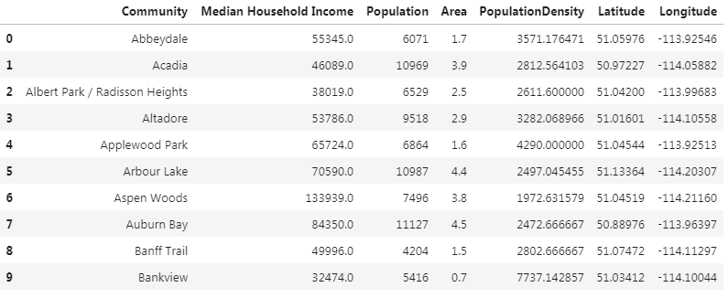
Data sources
Neighborhood and area -Wiki
Neighborhood demographics – great-news.ca
Geo data from Geocoder

Slide 6
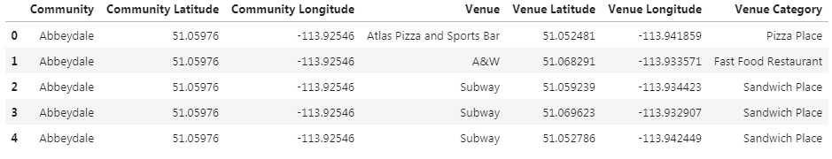
Venue data from Foursquare API - food Section ONLY
https://api.foursquare.com/v2/venues/explore?&client_id={}&client_secret={}&v={}&ll={},{}&radius={}&section={}&limit={}'.format(
CLIENT_ID,
CLIENT_SECRET,
VERSION,
lat,
lng,
radius,
SECTION,
LIMIT)

Slide 7
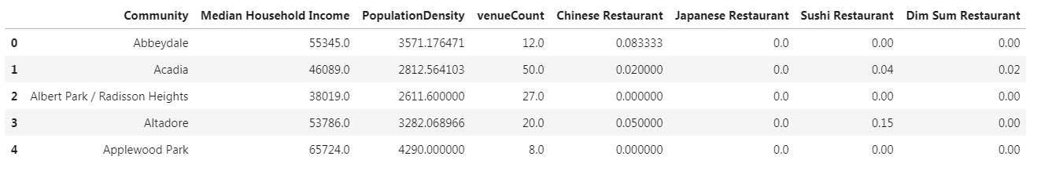
Feature Extraction

Slide 8
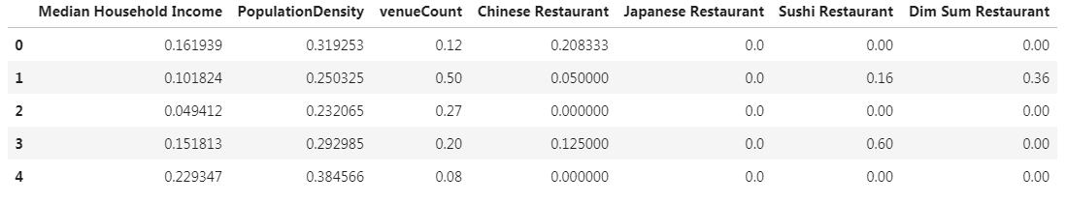
Data normalization – max/min scaler
featureDF_scaled = featureDF - featureDF.min()
featureDF.max() - featureDF.min()

Slide 9
Find k with Elbow method – K-means clustering
k: Optimal number of clusters
Distortion: average of the squared distances from the cluster centers of the respective clusters.
Inertia: sum of squared distances of samples to their closest cluster center.

Slide 10
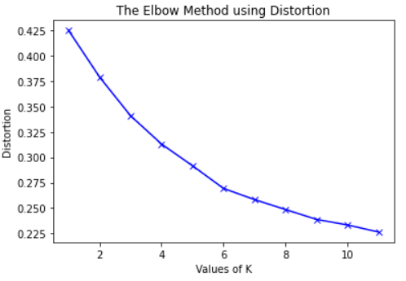
Elbow method using Distortion( k = 5 )

Slide 11
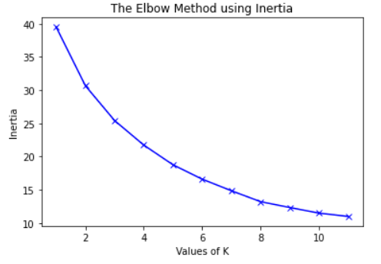
Elbow method using Inertia( k = 5 )

Slide 12
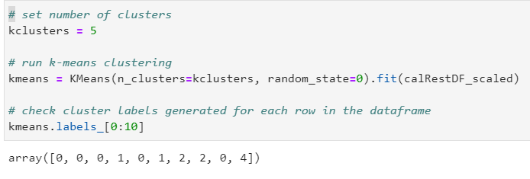
K-means clustering (k = 5)

Slide 13
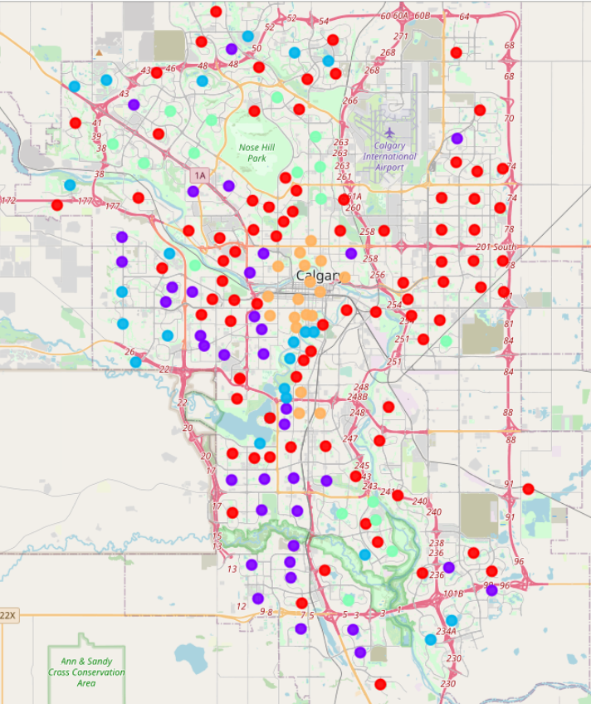
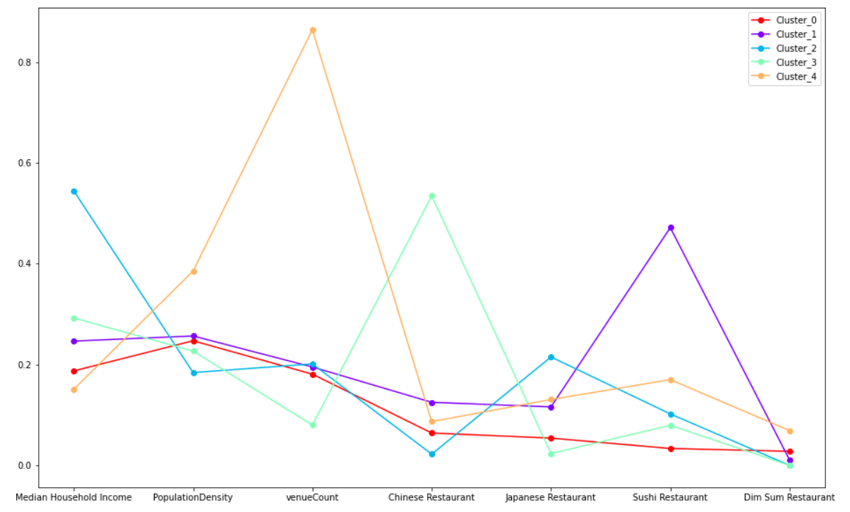
Clustering analysis based on map, line graph
 | Family Income | Population Density | Food Venue Coverage | East Asian Restaurant Coverage
CLUSTER 0 | LOW | MEDIUM | FAIR | low East Asian restaurant coverage
CLUSTER 1 | MEDIUM | MEDIUM | MEDIUM | fair Chinese/Japanese restaurant coverage, but highest Sushi restaurant coverage
CLUSTER 2 | HIGHEST | LOWEST | MEDIUM | highest Chinese restaurant coverage, but low Sushi restaurant coverage
CLUSTER 3 | HIGH | LOW | LOWEST | highest Chinese restaurant coverage, but low Sushi restaurant coverage
CLUSTER 4 | LOWEST | HIGHEST | HIGHEST | high East Asian restaurant coverage
BASED ON THE ANALYSIS:
CLUSTER 2 AND 3 ARE HIGHLY RECOMMEDED FOR A HIGH-END SUSHI RESUTAURANT
CLUSTER 4 IS RECOMMEDED FOR A LOW-END FAST- FOOD SUSHI RESTAURANT CATERING TO DOWNTOWN/ CBD CUSTOMERS

Slide 14
HOW CAN WE FURTHER IMPROVE THE ANAYSIS:
Improved Foursquare data
More neighborhood data, such as: median rent, median age, proximity to C-train line, and etc.
Try other clustering algorithm, Hierarchical clustering, and compare performance

Slide 15
Thank you
THANK YOU

